Slide 1

ADMM in PyTorch
Alternating Direction Method of Multipliers
Bittu Sharma
Kushagra Jain
Milan Parmar
Shibashish Behra

Slide 2
Motivation
Decentralized optimizations
Superfast when run in parallel
Minimal assumptions on objective function and constraints
Loss function doesn’t need to be differentiable
Notes:
4th point: assumptions only on f and g

Slide 3
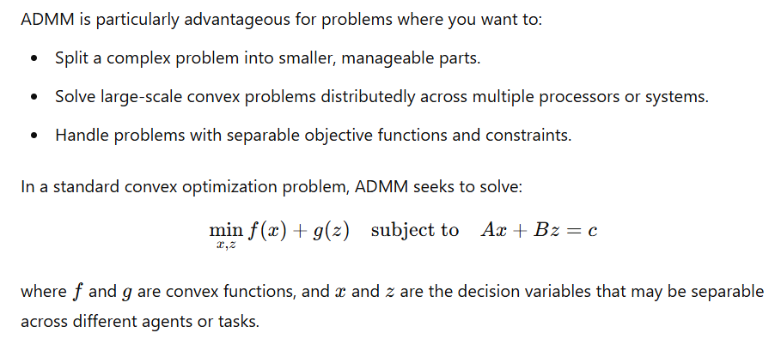
ADMM Algorithm

Slide 4
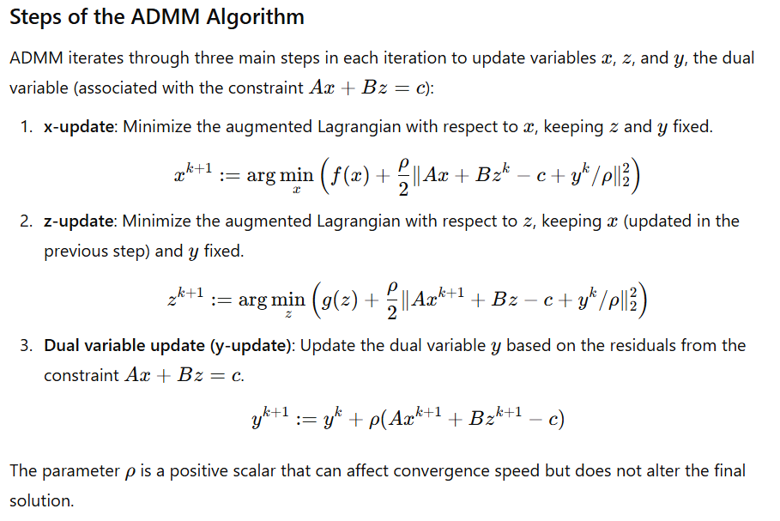
ADMM Algorithm

Slide 5
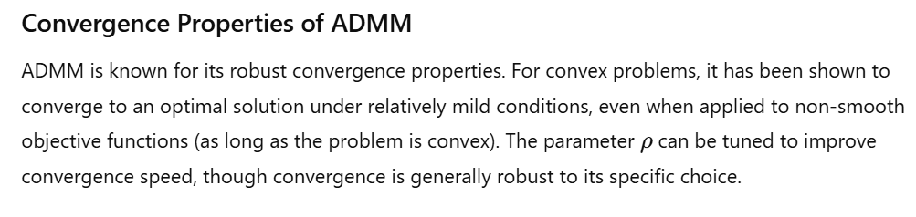
ADMM Algorithm

Slide 6
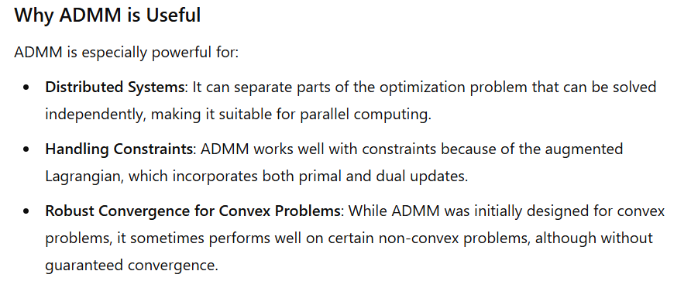

Slide 7

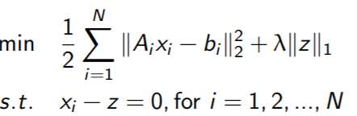
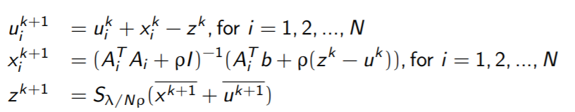
ADMM for Lasso
Lasso Problem :
Distributed ADMM Form:
Update Rules:

Slide 8
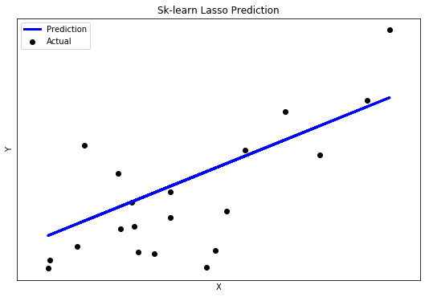
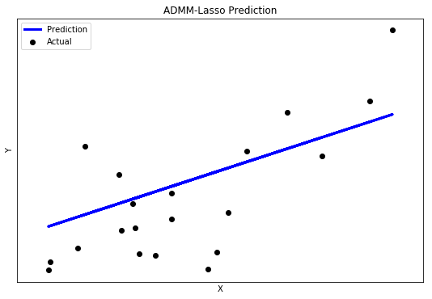
Results
Compared the results for Lasso with sklearn implementation on Diabetes Dataset
MSE: 2553.13 2769.15

Slide 9



2. ADMM for Ridge Regression
Ridge Regression :
ADMM Form :
Update Rules:

Slide 10
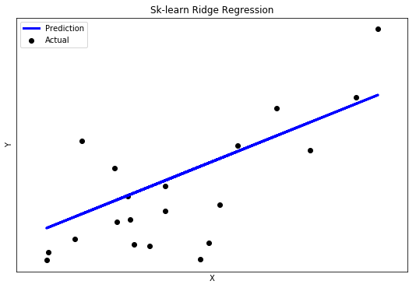
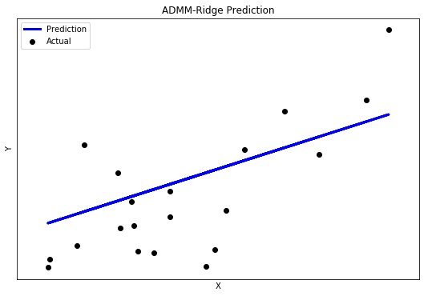
Results
Compared the results for Lasso with sklearn implementation on Diabetes Dataset
MSE: 2559.32 2799.13

Slide 11
References
http://web.stanford.edu/~boyd/papers/pdf/admm_distr_stats.pdf
https://web.stanford.edu/~boyd/papers/pdf/admm_slides.pdf

